Slide 1
ADO.NET Entity Framework

Slide 2
Contents
Introduction to the Entity Framework
Creating a simple entity data model
Using entities in an application
EF techniques
Using the Entity Client API
Creating a full entity data model
Demos folder:
Demos-13-EF

Slide 3
1. Introduction to the Entity Framework
Overview of EF
Entity Data Models
Using entities
Querying entities

Slide 4
Overview of EF
What is the Entity Framework?
An Object-Relational Mapping API
Allows you to map database tables to classes, using VS wizards
These classes are known as "entity classes"

Slide 5
Entity Data Models
To use the Entity Framework in your application…
Add an Entity Data Model to your application
Specify the tables, views, stored procedures to map
An entity data model comprises 3 categories of mapping metadata
Conceptual model
Defines entity classes / relationships
Physical model
Database storage details
Logical model
Maps entity classes / relationships to tables / FKs

Slide 6
Using Entities
Your application can manipulate data in memory as entity objects
Load database data into entities
Create, modify, and delete entities
Then synchronise entities back to the database
Entities are managed by "Object Services"
Monitors client-side changes to entities
Manages relationships between entities
Allows you to save changes without writing any SQL

Slide 7
Querying Entities
The usual way to query entities is by using LINQ to Entities
Uses familiar LINQ operators and techniques
You can also use Entity SQL
An object-oriented version of SQL
Not as commonly used as LINQ to Entities

Slide 8
2. Creating a Simple Entity Data Model
Overview
Creating an entity data model
Viewing the entity data model
Using the Entity Data Model Browser
Reshaping the entity model
Viewing the generated entity classes
Viewing the generated context class
Viewing the generated mapping files

Slide 9
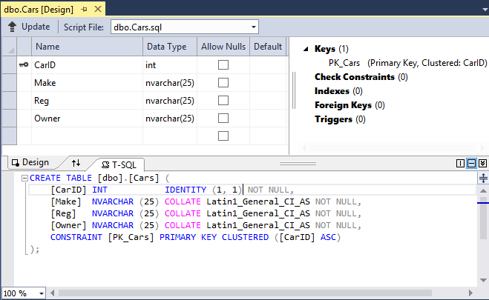
Overview
In this section we'll see create a simple entity data model
See the SimpleDemo example
The entity data model will map the following db table
In the CarsDatabase LocalDB database, see the Cars table
(To create db, see C:\CSharpDev\Databases\readme.txt)

Slide 10
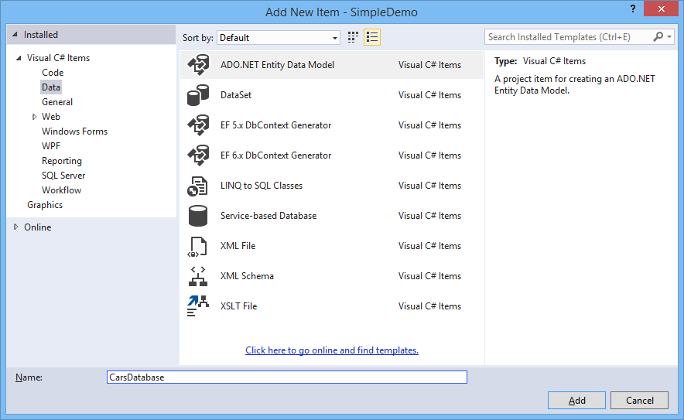
Creating an Entity Data Model (1 of 5)
To create an entity data model:
Add an ADO.NET Entity Data Model to your project

Slide 11
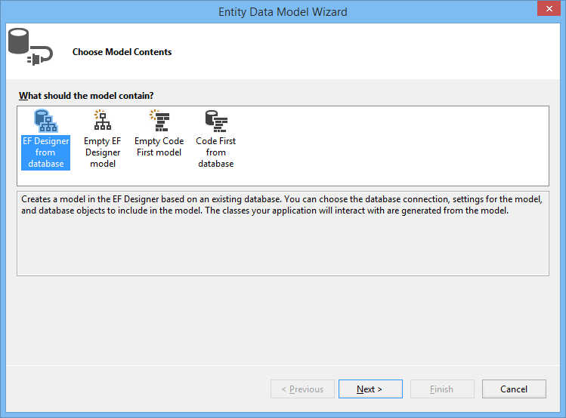
Creating an Entity Data Model (2 of 5)
In the Choose Model Contents screen, choose one of the available options
We'll choose EF Designer from Database here

Slide 12
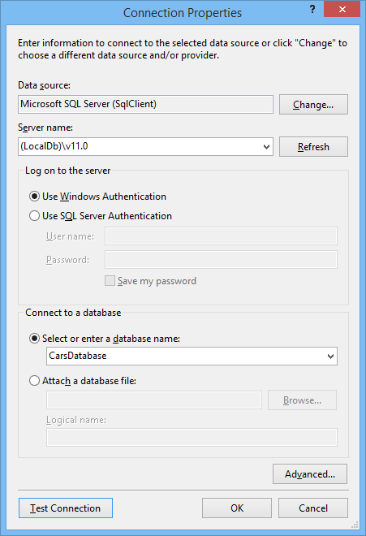
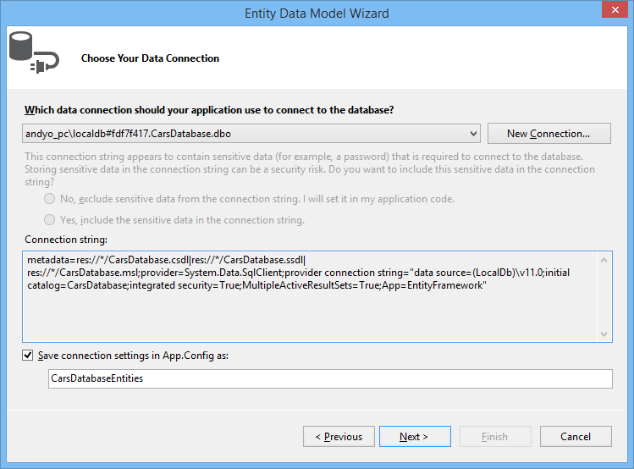
Creating an Entity Data Model (3 of 5)
Choose Your Data Connection screen:
Choose an existing connection, or specify a new one
The connection string references 3 metadata files
Will contain mapping info at run time

Slide 13
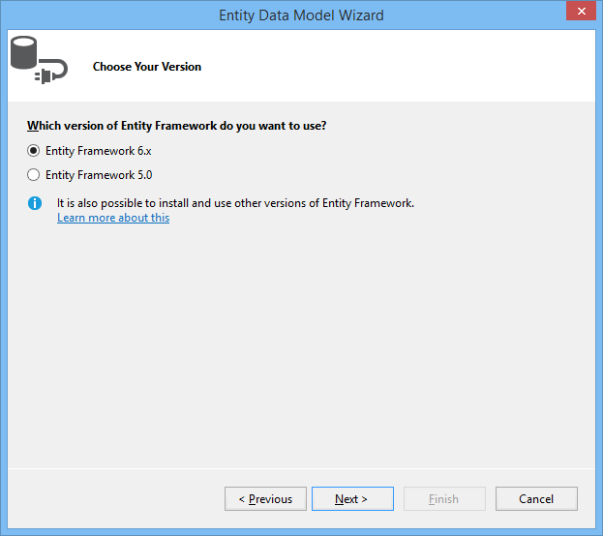
Creating an Entity Data Model (5 of 5)
Choose Your Version screen:
Choose which version of the Entity Framework you want to use

Slide 14
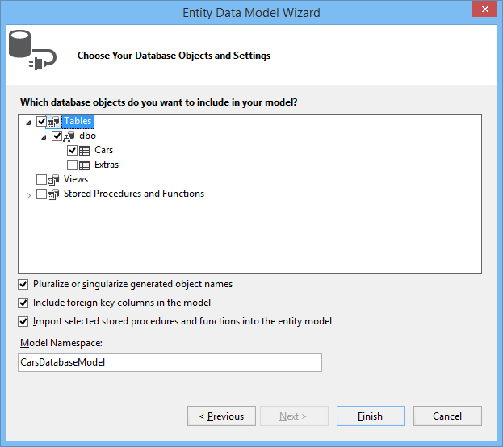
Creating an Entity Data Model (5 of 5)
Choose Your Database Objects screen:
Choose tables, views, and stored procedures to map

Slide 15
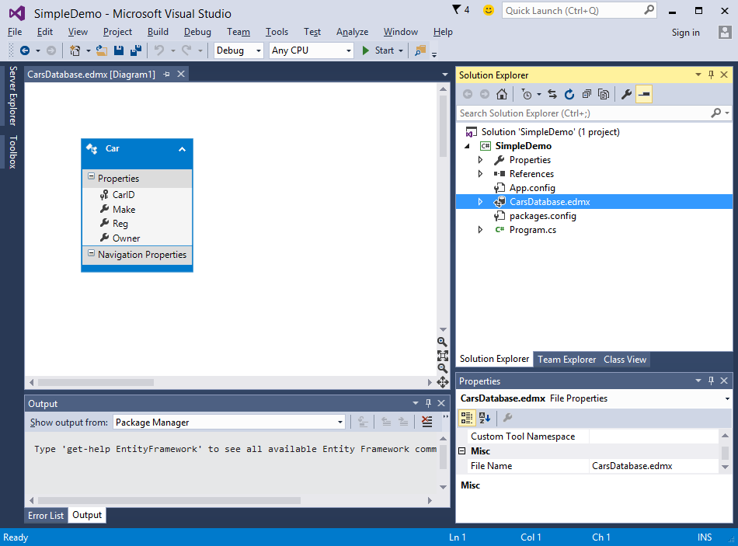
Viewing the Entity Data Model
VS generates an .edmx file and displays it in the Designer

Slide 16
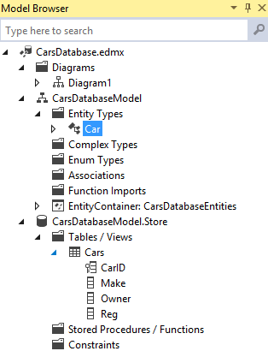
Using the Entity Data Model Browser
Select the following menu item:
View | Other Windows | Entity Data Model Browser
Lots of useful information here:
Conceptual model
Entity types and associations between them
Physical model
Physical storage information

Slide 17
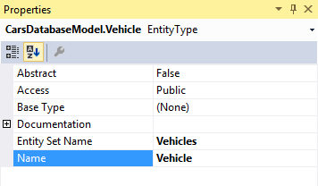
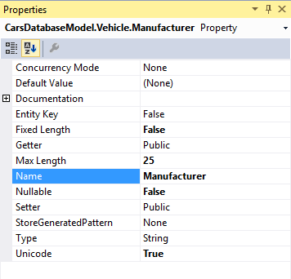
Reshaping the Entity Model
You can change the name of your entity type
Select the entity type in the Model Browser window
Change its name in the Properties window
You can also change property names in the entity
Select a property in the Model Browser window
Change its name in the Properties window

Slide 18
Viewing the Generated Entity Classes
To view the generated entity classes:
Expand CarsDatabase.edmx
Then expand CarsDatabase.tt
Contains entity classes, e.g. Vehicle
Contain properties mapped to database columns

Slide 19
Viewing the Generated Context Class
To view the generated context class:
Expand CarsDatabase.edmx
Then expand CarsDatabase.Context.tt
Contains a context class, e.g. CarsDatabaseEntities
Inherits from DbContext
Has DbSet properties, e.g. DbSet<Vehicle>

Slide 20
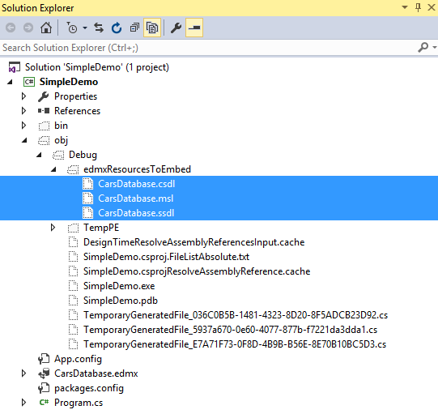
Viewing the Generated Mapping Files
When you build the project, three XML mapping files are created
See obj\Debug\edmxResourcesToEmbed folder
Contain the three categories of mapping info
Automatically embedded as resources into .exe file
Conceptual model
Logical (mapping) model
Physical (storage) model

Slide 21
3. Using Entities in an Application
Overview
The role of the DbContext class
Querying entities
Adding entities
Deleting entities
Modifying entities
Additional query techniques

Slide 22
Overview
In this section we'll see how to manage entities in an application
Load entities from a database
Create new entities in memory
Modify existing entities
Delete existing entities

Slide 23
The Role of the DbContext Class
The DbContext class plays a key role
Our DbContext subclass is CarsDatabaseEntities
DbContext is a LINQ data source
So you can use it in your LINQ queries
It also has a SaveChanges() method, to save pending (in-memory) changes to the database
DbContext maintains sets of entities
Via DbSet<T> properties, such as Vehicles
Allows you to access these entities in your code

Slide 24
Querying Entities
This example shows how to query entities
private static void DisplayAllVehicles()
{
using (CarsDatabaseEntities context = new CarsDatabaseEntities())
{
foreach (Vehicle v in context.Vehicles)
Console.WriteLine(v);
}
}
A SQL SELECT statement will be executed here

Slide 25
Adding Entities
This example shows how to add an entity
private static void AddVehicle()
{
using (CarsDatabaseEntities context = new CarsDatabaseEntities())
{
try
{
context.Vehicles.Add(new Vehicle
{
CarID = 1234,
Manufacturer = "Ferrari",
Reg = "FF01 555",
Owner = "Fernando"
});
context.SaveChanges();
}
catch (Exception ex)
{
Console.WriteLine(ex.InnerException.Message);
}
}
}
A SQL INSERT statement will be executed here

Slide 26
Deleting Entities
This example shows how to delete an entity
private static void DeleteVehicle()
{
Console.Write("Enter ID of vehicle to delete: ");
int id = int.Parse(Console.ReadLine());
using (CarsDatabaseEntities context = new CarsDatabaseEntities())
{
// We can use EF API to lookup entity.
// EntityKey key = new EntityKey(" CarsDatabaseEntities.Vehicles","CarID",id);
// Vehicle vehicleToDelete = (Vehicle)context.GetObjectByKey(key);
// Or we can use LINQ to Entities to lookup entity.
Vehicle vehicleToDelete = (from v in context.Vehicles
where v.CarID == id
select v).FirstOrDefault();
if (vehicleToDelete != null)
{
Console.Write("Are you sure you want to delete: {0}? ", vehicleToDelete);
if (Console.ReadLine().ToUpper()[0] == 'Y')
{
context.Vehicles.Remove(vehicleToDelete);
context.SaveChanges();
}
}
}
}
A SQL DELETE statement will be executed here

Slide 27
Modifying Entities
This example shows how to modify an entity
private static void ChangeOwner()
{
Console.Write("Enter ID of vehicle: ");
int id = int.Parse(Console.ReadLine());
Console.Write("Enter new owner: ");
string newOwner = Console.ReadLine();
using (CarsDatabaseEntities context = new CarsDatabaseEntities())
{
// We can use EF API to lookup entity.
// EntityKey key = new EntityKey("CarsDatabaseEntities.Vehicles","CarID",id);
// Vehicle vehicleToChangeOwner = (Vehicle)context.GetObjectByKey(key);
// Or we can use LINQ to Entities to lookup entity.
Vehicle vehicleToChangeOwner = (from v in context.Vehicles
where v.CarID == id
select v).FirstOrDefault();
if (vehicleToChangeOwner != null)
{
vehicleToChangeOwner.Owner = newOwner;
context.SaveChanges();
}
}
}
A SQL UPDATE statement will be executed here

Slide 28
Additional Query Techniques
You can select particular entity fields:
You can select projections:
You can invoke LINQ extension methods:
var vehicleManufacturers = from v in context.Vehicles
select v.Manufacturer;
var vehicleSummaries = from v in context.Vehicles
select new { v.Reg, v.Manufacturer };
var countWalesCars = (from v in context.Vehicles
where v.Reg.StartsWith("C")
select v.CarID).Count();

Slide 29
4. EF Techniques
Logging queries
Compiled queries
IEnumerable vs. IQueryable
Transactions and the Entity Framework

Slide 30
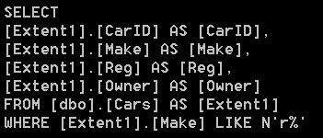
Logging Queries
You can view the SQL that will be generated when you execute a IQueryable<T> query
Call ToString() on the IQueryable<T> object
Example:
using (CarsDatabaseEntities context = new CarsDatabaseEntities())
{
IQueryable<Vehicle> vehs = from v in context.Vehicles
where v.Manufacturer.StartsWith("r")
select v;
Console.WriteLine(vehs.ToString());
…
}

Slide 31
Compiled Queries
When you use DbContext, EF automatically caches the generated SQL for you
When you execute a query, it searches the cache for already compiled queries
However, if you use ObjectContext, you must create a compiled query yourself
Call CompiledQuery.Compile(), which returns a delegate that represents the compiled query
See http://msdn.microsoft.com/en-us/library/bb896297.aspx

Slide 32
IEnumerable vs. IQueryable
What's the difference between using IEnumerable<T> and IQueryable<T> in a LINQ to Entities query?
IEnumerable<T> example
First causes a "SELECT * FROM Employees" to load all records into memory, then filters the entities in memory. Eek!!!
IQueryable<T> example
Causes a "SELECT * FROM Employees where Age >= 30"
Much better performance than the IEnumerable<T> example
IEnumerable<Employee> emps = context.Employees;
var emps30plus = emps.Where(e => e.Age >= 30);
IQueryable<Employee> emps = context.Employees;
var emps30plus = emps.Where(e => e.Age >= 30);

Slide 33
Transactions and the Entity Framework
EF supports automatic transaction enlistment
You can enclose entity queries and updates within a System.Transactions transaction
Reasons for using transactions in EF:
To execute multiple ops against a data source that must be highly consistent
E.g. queries that depend on the successful completion of object changes
To coordinate changes in the object context with other distributed operations
E.g. sending an e-mail or writing to a message queue

Slide 34
5. Using the Entity Client API
Overview
Data Provider for EF - classes and interfaces
Example

Slide 35
Overview
The EF includes an "entity client API"
This is the magic that translates database data to entities in memory, via the Data Provider for EF
In System.Data.Entity.Core.EntityClient namespace
Normally you don't bother using the entity client API in your own code
But you can if you like
E.g. you can use EntityDataReader to read entities using familiar a "data reader" approach
Used in conjunction with Entity SQL
See example on next slide

Slide 36
Data Provider for EF - Classes and Interfaces
EntityConnection
Contains reference to conceptual model and data source conn^{n}.
EntityTransaction
Specifies the transaction for an EntityCommand
EntityCommand
Represents a command for the conceptual layer
EntityParameter, EntityParameterCollection
Represent parameters used by an EntityCommand
EntityDataReader
Reads a forward-only stream of rows from a data source

Slide 37
Example
private static void ProcessVehiclesUsingEntityDataReader()
{
// Make a connection object, based on our *.config file.
using (EntityConnection cn = new EntityConnection("name=CarsDatabaseEntities"))
{
cn.Open();
// Now build an Entity SQL query.
string query = "SELECT VALUE vehicle FROM CarsDatabaseEntities.Vehicles AS vehicle";
// Create a command object.
using (EntityCommand cmd = cn.CreateCommand())
{
cmd.CommandText = query;
// Finally, get the data reader and process records.
using (EntityDataReader dr = cmd.ExecuteReader(CommandBehavior.SequentialAccess))
{
Console.WriteLine("\nAll vehicle details, retrieved using entity client API:");
while (dr.Read())
{
Console.WriteLine("[{0}] {1}, {2}, {3}", dr["CarID"],
dr["Manufacturer"],
dr["Reg"],
dr["Owner"]);
}
}
}
}
}

Slide 38
6. Creating a Full Entity Data Model
Overview
Viewing the entity data model
Importing stored procedures
Navigating relationships
Invoking stored procedures

Slide 39
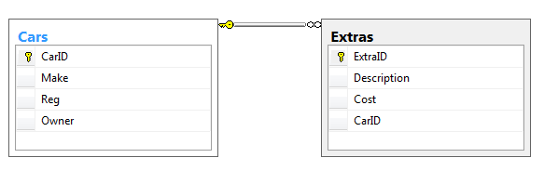

Overview
In this section we'll create a full entity data model
See the FullDemo example
One-to-many relationship between Cars and Extras
Plus a stored procedure

Slide 40
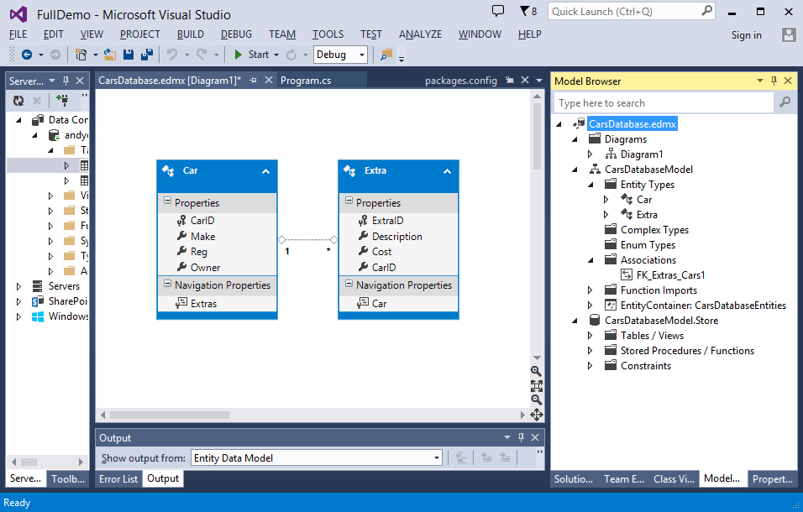
Viewing the Entity Data Model
Note the following points in the entity data model
The Car and Extra entity types
The association between the Extras and Cars tables
The navigation properties that allow you to navigate between a car and its extras, and vice versa

Slide 41
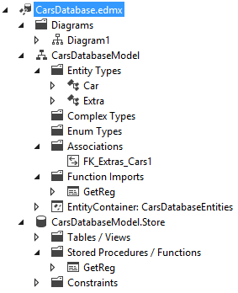
Stored Procedures
If you've included stored procedures in your entity model…
They are automatically mapped to functions in your entity model

Slide 42
Navigating Relationships (1 of 3)
To navigate a one-to-many relationship…
E.g. for a given car, get all its extras
You can influence when the related entities are loaded…
private static void DisplayExtrasForCar(int carID)
{
using (CarsDatabaseEntities context = new CarsDatabaseEntities())
{
var extras = from e in context.Extras
where e.CarID == carID
select e;
foreach (var e in extras)
{
Console.WriteLine(e);
}
}
}
context.Configuration.LazyLoadingEnabled = true; // Lazy loading
context.Configuration.LazyLoadingEnabled = false; // Eager loading

Slide 43
Navigating Relationships (2 of 3)
To navigate a many-to-one relationship…
E.g. for a given extra, get the car it belongs to
private static void DisplayCarsThatOwnExtras(IEnumerable<Extra> extras)
{
using (CarsDatabaseEntities context = new CarsDatabaseEntities())
{
foreach (Extra extra in extras)
{
var theCar = (from c in context.Cars
where c.CarID == extra.CarID
select c).First();
Console.WriteLine("{0}, registration {1}, owner {2}, has {3} extras.",
theCar.Make,
theCar.Reg,
theCar.Owner,
theCar.Extras.Count());
}
}
}

Slide 44
Navigating Relationships (3 of 3)
To add an entity in a many-to-one relationship…
E.g. add an extra to a car
private static void AddEjectorSeatToCar(int carID)
{
using (CarsDatabaseEntities context = new CarsDatabaseEntities())
{
var theCar = (from c in context.Cars
where c.CarID == carID
select c).First();
theCar.Extras.Add(new Extra { Description = "Ejector seat", Cost = 40000 });
context.SaveChanges();
}
}

Slide 45
Invoking Stored Procedures
To invoke a stored procedure…
Call the mapped function in the entity model
Use ObjectParameter to specify types for in-out params, and to access values after execution
private static void DisplayAllCarRegsUsingStoredProcedure()
{
using (CarsDatabaseEntities context = new CarsDatabaseEntities())
{
var theCars = from c in context.Cars
select c;
foreach (var c in theCars)
{
ObjectParameter objectParam = new ObjectParameter("reg", typeof(String));
context.GetReg(c.CarID, objectParam);
Console.WriteLine("CarID {0} has registration {1}",
c.CarID,
objectParam.Value);
}
}
}

Slide 46
Any Questions?

